Slide 1
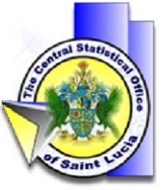
Using a Content Management System Website for the Dissemination of Official Statistics
UN Regional Workshop on Data Dissemination
and Communication, IBGE, Rio de Janeiro, Brazil,
5-7 June 2013
By Edwin St Catherine,
Director of Statistics, SAINT LUCIA

Slide 2
Open Data Objective of Website Re-design
Data which are:
Free of cost
Free of barriers to redistribution
Machine readable and in reusable formats
Well indexed and ‘findable’
A concept, a movement
International initiatives - Joomla
Rooted in the language of ‘data liberation’
Newer aspects include application development, mash-ups, linked data and the semantic web

Slide 3
Using Available Web Dissemination Tools
Redatam for the dissemination of data from Census and survey databases
DevInfo for the dissemination of national indicators
Support from ECLAC and UNICEF and based on New Project supported by the CDB (Caribbean Development Bank) for strengthening the use of DEV INFO in the Region.

Slide 5
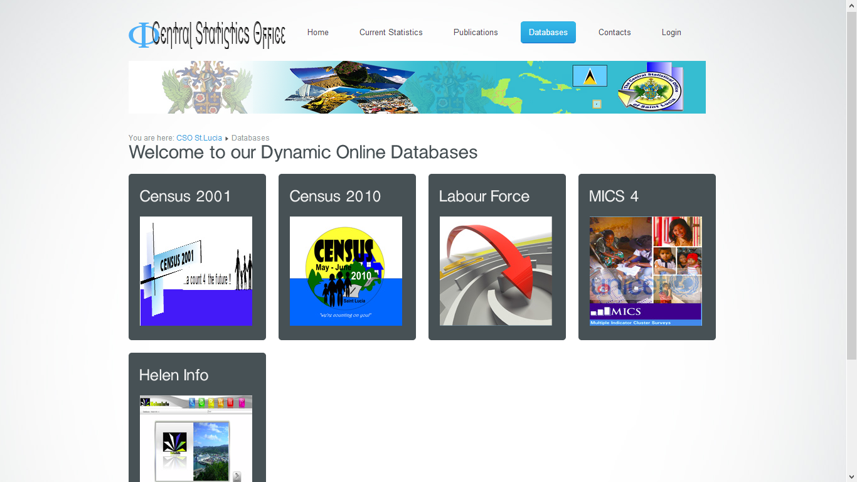

Slide 6
WebSite Management
Ensures that persons within units of our department with direct responsibility for the production and approval of data were responsible within agreed norms for the content of specific articles published on the website.
Designed so that designated staff is allowed to login and update website content based on security rights.

Slide 7
WebSite Management
Website content can be uploaded and managed by staff without any knowledge of specific web publishing technologies.
Creating content is simple with the WYSIWYG editor, giving even novice users the ability to combine text, images in an attractive way
Specific knowledge of web publishing technologies to update the website is not required.
Avoid the overreliance of the Central Statistics Office on a few individuals. This new model is therefore more resilient.

Slide 8
WebSite Management
In managing the dissemination process, roles, rights and responsibilities for updating specific segments in the website are clear and respect the established hierarchy of responsibility within the unit of the Central Statistics Office.

Slide 9
Features of the Web CM System
Web Link Management
Providing link resources for site users sorted into categories
Simplified three-tiered system of articles
storage logic in keeping with our own internal needs within the Central Statistical Office.
Increased interaction with users
users can rate articles and data on the site
users can e-mail the articles/tables and analysis provided to a friend
automatically save a PDF or excel file for their own use

Slide 10
Features of the Web CM System
feedback from website users on the most popular articles
latest new items
Newsflashes
Web syndication
Web services (making API available)

Slide 11
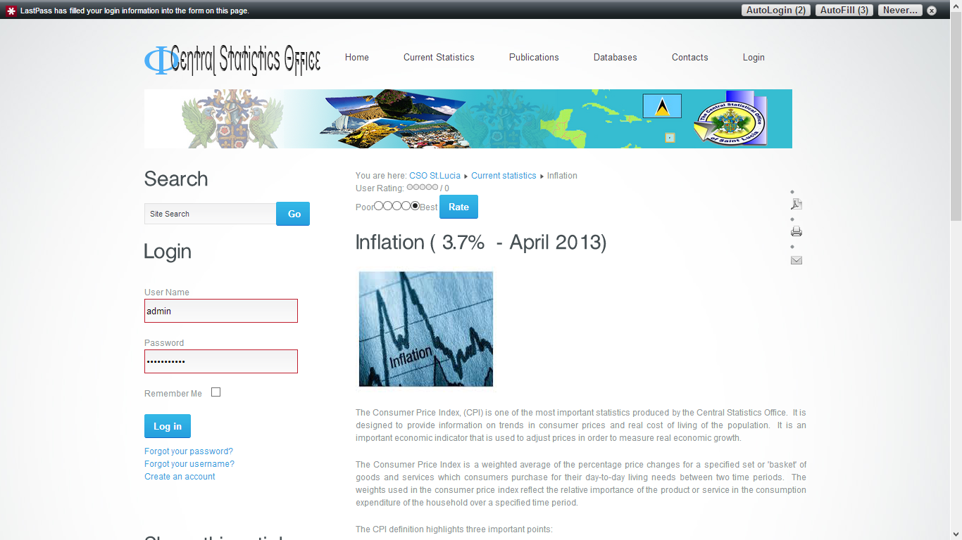

Slide 12
Link CMS System to NADA (National Data Archive)
Leverages the documentation which has already been developed for various Censuses and Surveys:
IHSN (International Household Survey Network) Metadata Editor
Preparation of metadata and data on our censuses, household and enterprise surveys for publishing in an online catalog which can be referenced from the Web CMS

Slide 13
Link CMS System to NADA (National Data Archive)
The metadata produced by the Editor is compliant with the Data Documentation Initiative (DDI) 2.n and the Dublin Core XML metadata standards
Integration ensures that researchers are able to relate information published on the site to detailed explanations of relevant concepts, methods, procedures associated with published data.

Slide 14
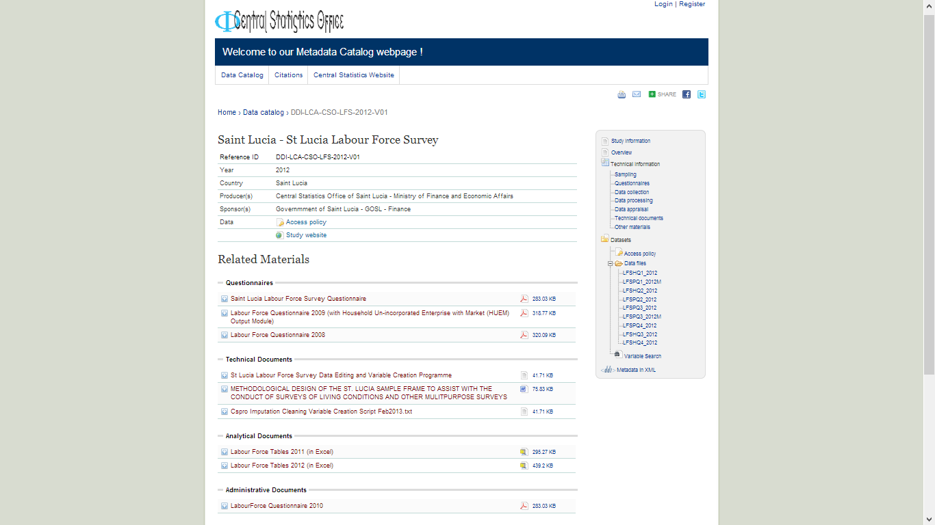

Slide 15
Ensure that CMS is Social to allow more effective interaction with Users
Articles can either
like or plus one (facebook, google plus) articles
Comment and post the comment along with a link to the article from our website to:
facebook, twitter, linkedin or google plus account
We would like to make the postings to our twitter account when articles are updated automatic
to encourage a larger following of the content which we post to our website.

Slide 16
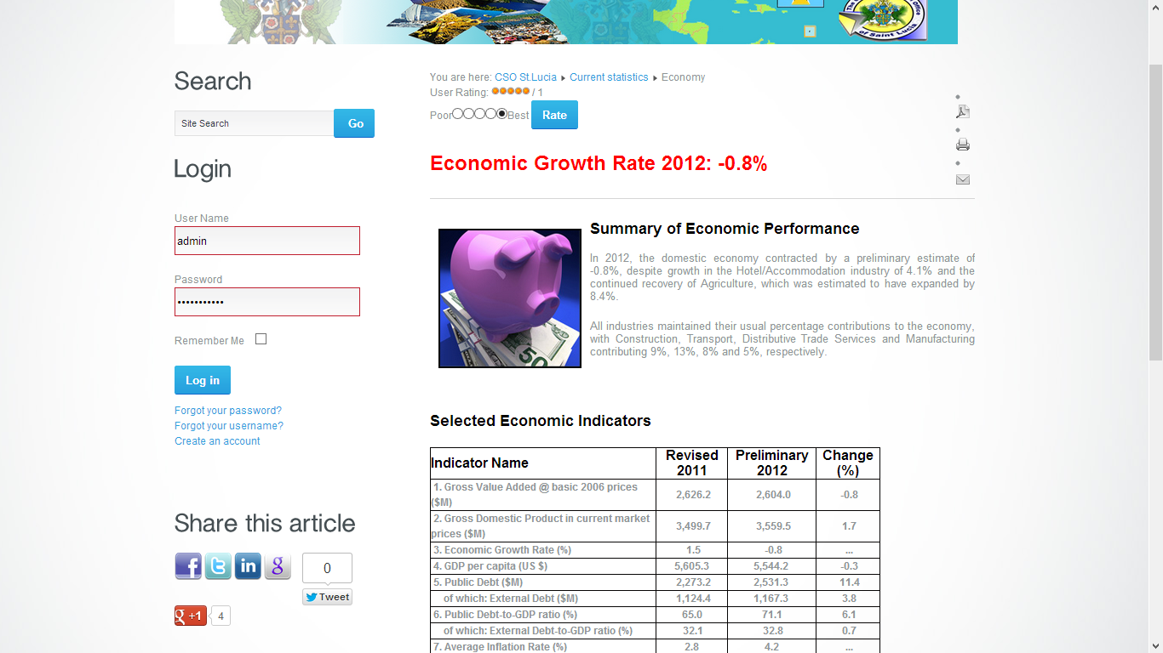

Slide 18
Thank you for your attention

